Slide 2
Virtualization & Cloud Concepts

Slide 3
Virtualization & Cloud Concepts
2.2 Summarize virtualization and cloud computing concepts
3.6 Given a scenario, apply cybersecurity solutions to the cloud

Slide 4
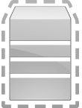
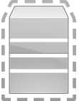
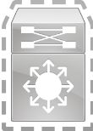
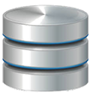
2.2 Summarize virtualization and cloud computing concepts
Virtualization
The main server in a virtualized sever is called the host
Virtual machines are called guests
Sandboxing is where an application is placed in its own VM
No access to run at the system level
Reduces risk from vulnerabilities
Chroot jail in a Linux environment
Isolated guest machine is known as a container
Snapshot is like taking a picture with a camera of the virtual machine's setting is at that time
First collected digital evidence from a compromised virtual host
Physical Server
Virtual Host
VM1 Guest
VM2 Guest
VM3 Guest
Virtual switch
Snapshot
(Copy of VM)
Containers
(Isolated Guest)
Sandboxing
(Isolated App)

Slide 5

2.2 Summarize virtualization and cloud computing concepts
Virtualization
Hypervisor 1 – Bare-Metal Architecture
Is a enterprise version that can be installed on a computer without an operating system, called bare metal.
OS 1
OS 2
Examples:
Operating system on the guest VM located within the virtual host
Software that provides direct access to virtual desktop on the guest VM
HP Laptop (client)
Hypervisor Software
Hardware

Slide 6

2.2 Summarize virtualization and cloud computing concepts
Virtualization
Hypervisor 2 – Hosted Architecture
Needs an operating system, such as Server 2016 or Windows 10, and then the hypervisor is installed like an application.
OS 1
OS 2
Examples:
Operating system on the guest VM located within the virtual host
Application that is launched from the windows 10 desktop that provides access to the virtual desktop on the guest machine
Windows 10 OS running on the HP Laptop
HP Laptop (client)
Hypervisor Software
Host OS
Hardware

Slide 7
2.2 Summarize virtualization and cloud computing concepts
Virtualization
Containers
A container allows the isolation of an application and its files and libraries
An isolated guest machine is known as a container
Allows software developers to deploy applications seamlessly across various environments.
Solution to securely store data
Solution for users that have a specific set of tools installed, which they must use to perform their duties
Can prevent installing/using other tools that are not permitted
Container Security
Implementation of security tools and policies
Ensures that your container is working as it was intended

Slide 8
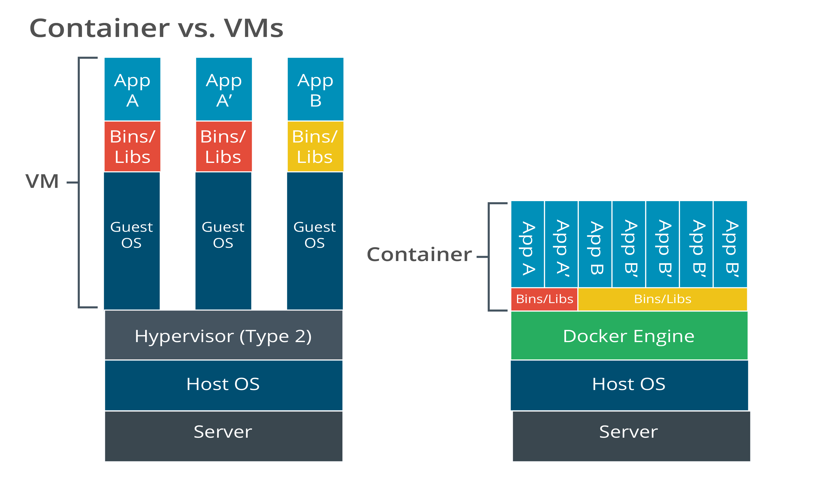
Virtualization Concepts

Slide 9
2.2 Summarize virtualization and cloud computing concepts
Virtualization
Virtual Desktop Infrastructure (VDI)
Is a pool of virtual desktop pools for groups of users or teams who share the same needs and access to the same applications and utilities on their desktops
Users can log in to any thin client located throughout the building and see the same desktop each time
Centralized server storage that hosts all required desktop applications
Prevents data from being stored on mobile devices
Thin client
Basic application usage with minimal operating system on the client (no huge memory or CPU needs)
Applications run on a remote server
Desktop as a Service (DaaS)
Local device is a keyboard, mouse, and screen

Slide 10
2.2 Summarize virtualization and cloud computing concepts
Virtualization
Virtual Desktop Environment (VDE)
Non-persistent
when the user logs off, the image reverts back to the original setting
Strategy that helps reduce risk if a rollback is needed when upgrading a critical system platform
Permanent
When the user logs off the image is saved

Slide 11
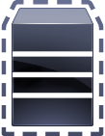
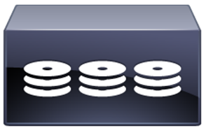
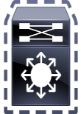
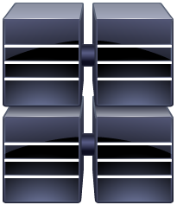


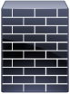
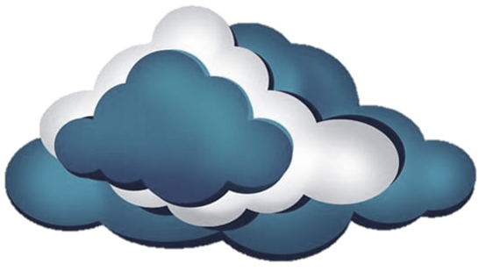

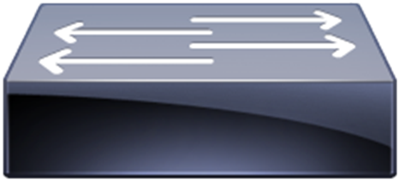
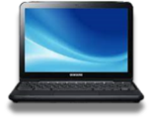
2.2 Summarize virtualization and cloud computing concepts
Virtualization
Virtual Desktop Infrastructure (VDI)
Virtual Host
VM1 Guest
VM2 Guest
VM3 Guest
Storage Area Network (SAN)
RAID
RAID
RAID
Virtual host inside the physical server within the server farm
Server Farm
Virtual switch
Firewall
FC Switch
Router
Internet
Snapshot
(Copy of VM)
Containers
(Isolated Guest)
Sandboxing
(Isolated App)
Ethernet Switch
Thin Clients

Slide 12
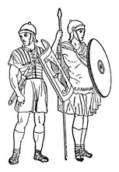
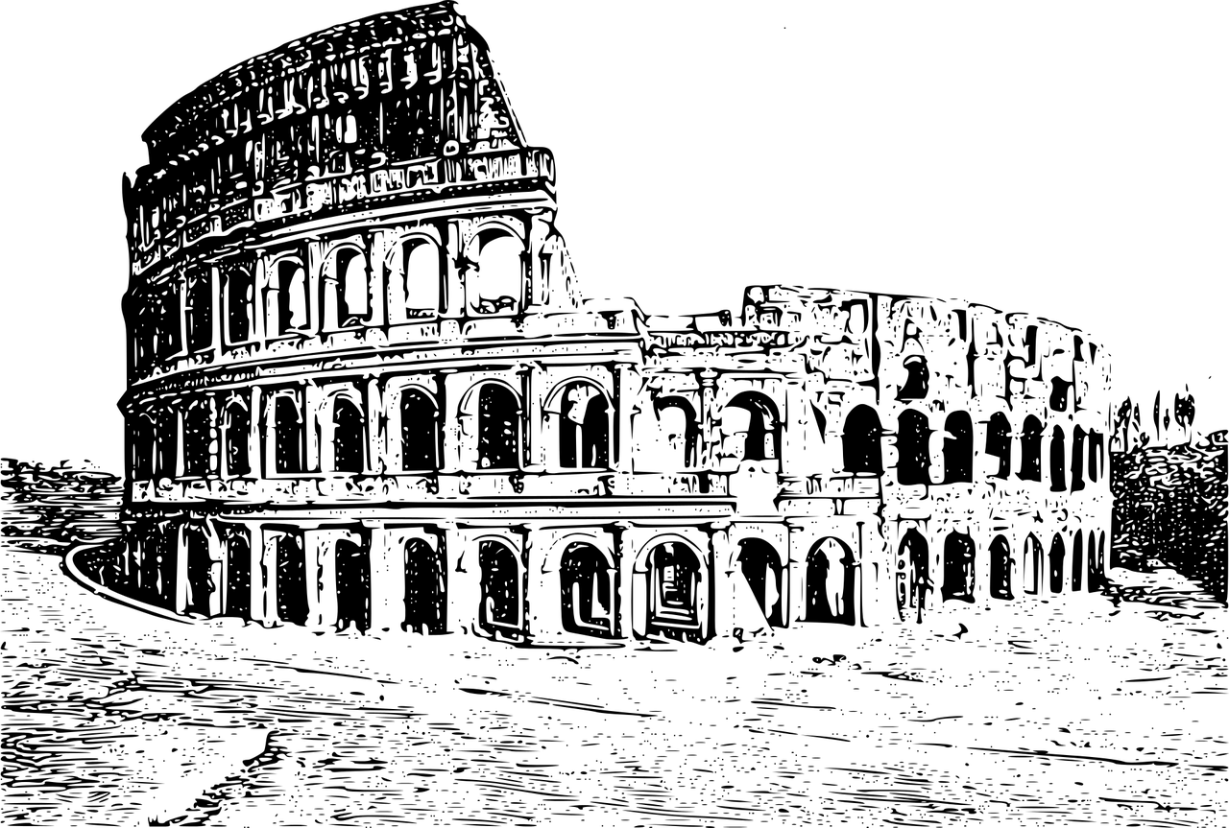
2.2 Summarize virtualization and cloud computing concepts
Virtualization Security Concerns
Virtual Machine Escape
Virtual Machine Sprawl

Slide 13
Answer the questions…
Your new application has multiple small processes that provide services to the network. You want to make this application run more efficiently by virtualizing it. What is the best approach for virtualization of this application?
Type II hypervisor
Linux KVM
Containerization
Type I hypervisor
How does a hypervisor enable multiple guest operating systems to run concurrently on a host computer?
Via a specialized driver package
By abstracting the hardware from the guest operating system
By providing specific virtual hardware to each guest OS
By hiding the underlying Linux operating system
Why is VM sprawl an issue?
VM sprawl uses too many resources on parallel functions
The more virtual machine in use, the harder it is to migrate a VM to a live server
Virtual machines are so easy to create, you end up with hundreds of small servers only performing a single function
When the servers are no longer physical, it can be difficult to locate a specific machine - VM sprawl is an issue because when virtual machines proliferate, they can be easily moved and potentially easily copied to random locations. This can make finding a specific machine difficult without a carefully constructed and consistently managed organizational structure.
13
Notes:
Answers
1. c - Containerization runs small applications on a host OS with virtually no overhead.
2. b - The hypervisor abstracts the hardware from the guest operating system to enable multiple guest operating systems to run concurrently on a host computer.
3. d

Slide 14

QUESTIONS?

Slide 15
Cloud Computing
There is no such thing as a cloud. The “cloud” is just somebody else’s computer
Notes:
Some good online cloud computing resources:
https://apprenda.com/library/cloud/
https://www.bmc.com/blogs/saas-vs-paas-vs-iaas-whats-the-difference-and-how-to-choose/
https://www.bigcommerce.com/blog/saas-vs-paas-vs-iaas/#the-key-differences-between-on-premise-saas-paas-iaas

Slide 16

2.2 Summarize virtualization and cloud computing concepts
Cloud Models
On Premises
Your applications are on local hardware
Your servers are in your data center in your building
Off-premises / hosted
Your servers are not in your building
They may not even be running on your hardware
Usually, a specialized computing environment
Infrastructure as a Service (IaaS)
Platform as a Service (PaaS)
Software as a Service (SaaS)
Customer
Managed
Provider
Managed
On Premises
IaaS
PaaS
SaaS
Application
Application
Application
Application
Data
Data
Data
Data
Runtime
Runtime
Runtime
Runtime
Middleware
Middleware
Middleware
Middleware
OS
OS
OS
OS
Virtualization
Virtualization
Virtualization
Virtualization
Servers
Servers
Servers
Servers
Storage
Storage
Storage
Storage
Networking
Networking
Networking
Networking
Notes:
On-premises vs Off-Premises
On-Premises

Slide 17
2.2 Summarize virtualization and cloud computing concepts
Cloud Models
Software as a Service (SaaS)
Cloud provider controls of the services and applications
Customized vendor application that cannot be modified
Use it with a pay-per-use model
On-demand software
No local installation
Customer controls access and provisions of its service to its users
Four examples of this— GMAIL, Goldmine, Salesforce, and Office 365:
SaaS
Application
Data
Runtime
Middleware
OS
Virtualization
Servers
Storage
Networking

Slide 18
2.2 Summarize virtualization and cloud computing concepts
Cloud Models
Platform as a Service (PaaS)
The vendor maintains an environment
Customers can migrate to it
Customers develop, run and manage their own
Customized application stack
Customized Websites
PaaS
Application
Data
Runtime
Middleware
OS
Virtualization
Servers
Storage
Networking

Slide 19
2.2 Summarize virtualization and cloud computing concepts
Cloud Models
Infrastructure as a Service (IaaS)
Outsource equipment
Cloud service provides customers with servers, storage, and networks but nothing else
No operating system installed (bare-bones)
Install an operating system, and maintain the patch management
Ability to provision servers on a self-service basis
Reduces the cost compared to on-premises
Replaces aging equipment unable to keep up with customer demand
IaS
Application
Data
Runtime
Middleware
OS
Virtualization
Servers
Storage
Networking

Slide 20
2.2 Summarize virtualization and cloud computing concepts
Cloud Models
Security as a service (SECaaS)
Provides secure identity management.
Business model in which a service provider integrates their security services into a corporate infrastructure on a subscription basis
Most cost-effective service for individuals
Corporations can provide on their own, when total cost of ownership is considered

Slide 21
2.2 Summarize virtualization and cloud computing concepts
Cloud Service Providers
Managed Security Service Provider (MSSP)
Reduced team and needs to operate an on-premises network and security infrastructure efficiently
Maintains the security environment for companies that will include
Enterprise firewalls
Intrusion Prevention and Detection Systems (IPDS)
SIEM systems
MSP support
Network connectivity management
Backups and disaster recovery
Growth management and planning

Slide 22
2.2 Summarize virtualization and cloud computing concepts
Cloud Models
Anything as a Service (XaaS)
A broad description of all cloud models
Network as a Service (NaaS)
Desktop as a Service (DaaS)
Backup as a Service (BaaS)
Use any combination of the cloud
Services delivered over the Internet
Not locally hosted or managed
Any IT function can be changed into a service

Slide 23
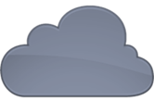
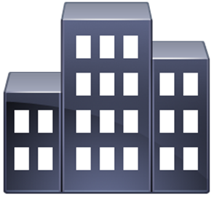
2.2 Summarize virtualization and cloud computing concepts
Cloud Models
Cloud deployment models
Public
Available to everyone over the Internet
Community
Several organizations share the same resources
Private
Your own virtualized local data center
Hybrid
A mix of public and private
Public
Community
Private

Slide 24
3.6 Given a scenario, apply cybersecurity solutions to the cloud
Cloud Networking Security
Private cloud
All internal IP addresses
Connect to the private cloud over a VPN
No access from the Internet
Segmentation
Strict set of rules controlling this traffic
Rules are enforced by the IP address ranges of each subnet
Private subnet, VLANs used in private subnet
Private subnet IP address ranges
10.0.0.0
172.16.x.x – 172.31.x.x
192.168.0.0

Slide 25
3.6 Given a scenario, apply cybersecurity solutions to the cloud
Cloud Networking Security
NAT Gateway
Allows the private subnets to communicate with other cloud services and the internet
Hides the internal network from internet users
NAT gateway has the Network Access Control List (NACL) for the private subnets
VPN Connection
Secure connection to your VPC
VPN using L2TP/IPsec to the public interface of the NAT gateway

Slide 26
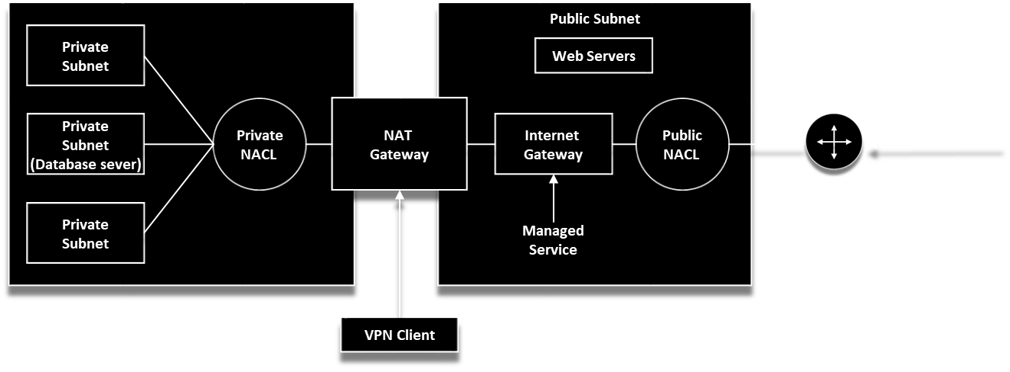
3.6 Given a scenario, apply cybersecurity solutions to the cloud
Cloud Networking Security
Virtual Private Cloud (VPC)
Consists of shared resources with a public cloud
VMs for one company are isolated from the resources of another company
Part of IaaS
Allows you to create a private connection between your VPC and another cloud service without crossing over the internet

Slide 27
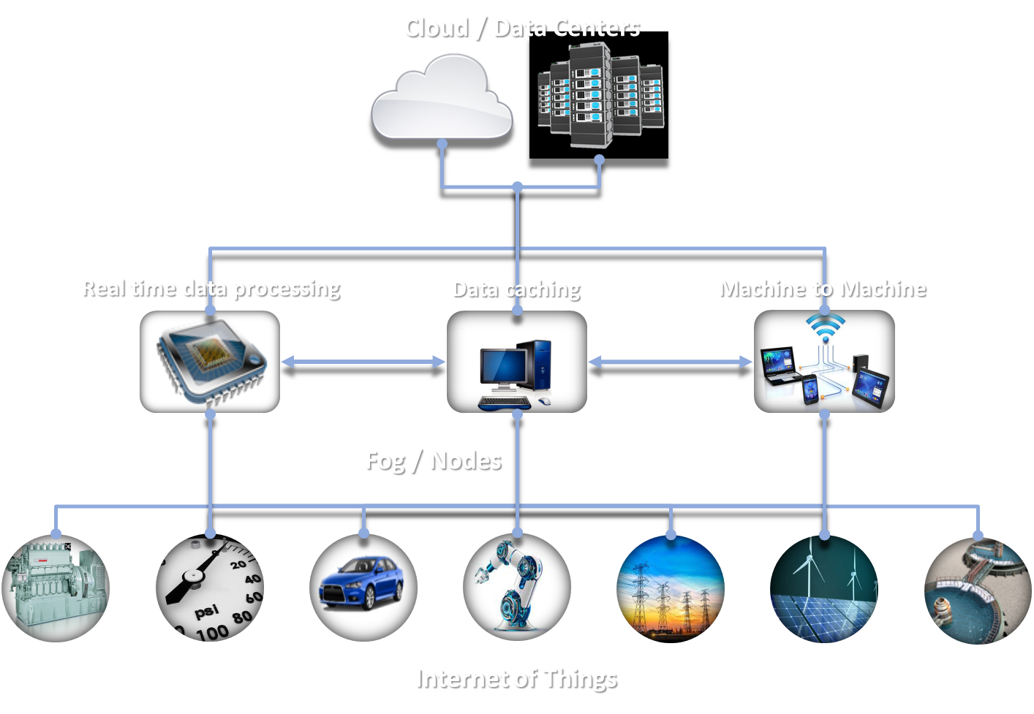
2.2 Summarize virtualization and cloud computing concepts
Cloud Service Providers
Fog Computing
Intermediary between the device and the cloud
Allows the data to be processed closer to the device
Reduces latency and cost

Slide 28
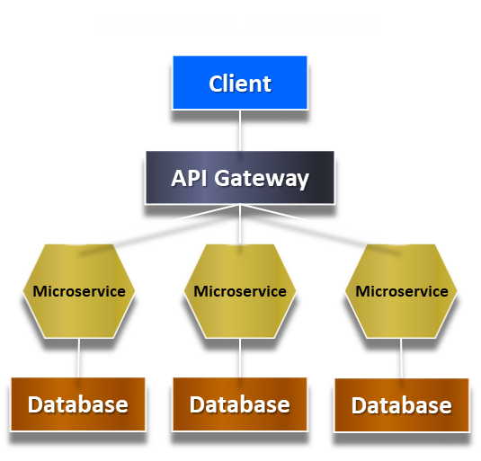
2.2 Summarize virtualization and cloud computing concepts
Edge Computing
All the processing of data storage is closer to the sensors rather than being thousands of miles away on a server at a data center
Microservices / API
This allows you to define individual services that can then be connected by using an application program interface
Microservices is an architecture style that
Divides a system into a series of small modules
That can be coupled together to produce a
Complete system. Each of the modules in a micro-
Services architecture is designed to be lightweight,
With simple interfaces and structurally complete.
This allows for more rapid development and
maintenance of code.

Slide 29
3.6 Given a scenario, apply cybersecurity solutions to the cloud
Cloud Security Controls
Cloud Storage Security
Cloud Networking Security
Cloud Computing Security
Cloud Security Solutions

Slide 30

Professor Messer: Securing Cloud Storage
Notes:
https://www.youtube.com/watch?v=cdwuFngVQHo

Slide 31
3.6 Given a scenario, apply cybersecurity solutions to the cloud
Cloud Security Controls
High Availability Across Zones
HA across zones
Availability zones (AZ)
Isolated locations within a cloud region (geographical location)
AZ commonly spans across multiple regions
Each AZ has independent power, HVAC, and networking
Build applications to be highly available (HA)
Run as active/standby or active/active
Application recognizes an outage and moves to the other AZ
Use load balancers to provide seamless HA
Users don’t experience any application issues

Slide 32
3.6 Given a scenario, apply cybersecurity solutions to the cloud
Cloud Security Controls
Secrets management
Cloud computing includes many secrets
API keys
Passwords
Certificates
Manage an access control policy
Limit users to only necessary secrets
Provide an audit trail
Know exactly who accesses secrets and when

Slide 33
3.6 Given a scenario, apply cybersecurity solutions to the cloud
Cloud Security Controls
Integration and Auditing
Test that these controls and the system integration are working as expected
Some controls may include the following:
Encryption Levels
Access Control Lists
Privilege Account Use
Password Policies
Anti-Phishing Protection
Data Loss Prevention Controls

Slide 34
3.6 Given a scenario, apply cybersecurity solutions to the cloud
Cloud Storage Security
Cloud storage
Data is on a public cloud
May not be public data
Access can be limited and protected
Data may be required in different geographical locations
A backup is always required
Availability is always important
Data is available as the cloud changes
Permissions
A significant cloud storage concern
One permission mistake can cause a data breach
Public access
Should not usually be the default

Slide 35
3.6 Given a scenario, apply cybersecurity solutions to the cloud
Cloud Storage Security
Encryption
Cloud data is more accessible than non-cloud data
More access by more people
Server-side encryption
Encrypt the data in the cloud
Data is encrypted when stored on disk
Client-side encryption
Data is already encrypted when it’s sent to the cloud
Performed by the application
Key management is critical

Slide 36
3.6 Given a scenario, apply cybersecurity solutions to the cloud
Cloud Storage Security
Replication
Copy data from one place to another
Real-time data duplication in multiple locations
Disaster recovery
High availability- Ensures that copies of your data are held in different locations
Scalability
Strategies a systems architect should use to minimize availability risks due to insufficient storage capacity
More storage than originally planned with little or no increase in cost
Maintain uptime if an outage occurs
Hot site for disaster recovery
Backups
Constant duplication of data

Slide 37

Professor Messer
Notes:
https://www.youtube.com/watch?v=ASLZhpvmT2k

Slide 38
3.6 Given a scenario, apply cybersecurity solutions to the cloud
Cloud Compute Security
Dynamic Resource Allocation
Virtualization technology to upgrade and down scale the cloud resources as the demand grows or falls
Elasticity
Dynamically allocating resources as needed (demand goes up service provided goes up)
Mitigates denial of service caused by a virtual machines environment's rapid elasticity
Cost-effective architecture to handle the variable capacity demand

Slide 39
3.6 Given a scenario, apply cybersecurity solutions to the cloud
Cloud Access Security Broker (CASB)
Enforces the company's policies between the on-premises situation and the cloud
Managed services of the back-end environment as part of its subscription
Extend local security policies to corporate resources hosted in a CSP’s infrastructure
Provides security, manageability, and visibility into the CSP platforms
SaaS
PaaS
IaaS

Slide 40
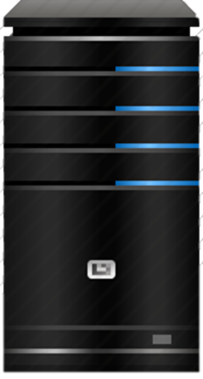
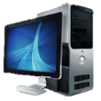
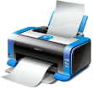

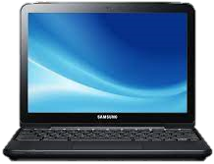

3.6 Given a scenario, apply cybersecurity solutions to the cloud
Cloud Security Solutions
Cloud Services
Located within the cloud
CASB (Cloud Access Security Broker)
Located before cloud access
SaaS
IaaS
PaaS
SECaaS
XaaS
CASB
Control and Monitoring
Compliance Management
Data Security
Threat Protection
Reverse Proxy - Forward Proxy - API Mode
On-Premises
Corporate Offices
Off-Premises
Mobile - Regional - Home
Offices

Slide 41
Answer the questions…
You have deployed a network of Internet-connected sensors across a wide geographic area. These sensors are small, low-power IoT devices, and you need to perform temperature conversions and collect the data into a database. The calculations would be best managed by which architecture?
Fog computing
Edge computing
Thin client
Decentralized database in the cloud
You are planning to move some applications to the cloud, including your organization’s accounting application, which is highly customized and does not scale well. Which cloud deployment model is best for this application?
SaaS
PaaS
IaaS
XaaS
A manufacturing company has moved an inventory application from their internal systems to a PaaS service. Which of the following would be the BEST way to manage security policies on this new service?
DLP
SIEM
IPS
CASB
41
Notes:
Answers
b - Edge computing on the way to the cloud would be the best fit given the lightweight processing capability of the IoT devices.
c - IaaS - Infrastructure as a Service is appropriate for highly customized, poorly scaling solutions that
d – Cloud Access Security Broker

Slide 42
Answer the questions…
Which of the following would be commonly provided by a CASB? (Select TWO)
A list of all internal devices that have not installed the latest security patches
A list of applications in use
Centralized log storage facility
List of network outages for the previous month
Verification of encrypted data transfers
VPN connectivity for remote users
Which of these cloud deployment models would share resources between a private virtualized data center and externally available cloud services?
SaaS
Community
Hybrid
Containerization
Notes:
Answers:
1. B and E (A CASB (Cloud Access Security Broker) can be used to apply security policies to cloud-based implementations. Two common functions of a CASB are visibility into application use and data security policy use. Other common CASB functions are the verification of compliance with formal standards and the monitoring and identification of threats.
The incorrect answers:
A (A CASB focuses on policies associated with cloud-based services and not internal devices.)
C (Using Syslog to centralize log storage is most commonly associated with a SIEM (Security Information and Event Manager).)
D (A network availability report would be outside the scope of a CASB.)
F (VPN concentrators are commonly used to provide security connectivity for remote users.)
2. C (A hybrid cloud model combines both private and public cloud infrastructures.)
The incorrect answers:
A. SaaS - Software as a Service (SaaS) is a cloud deployment model that provides on-demand software without any context about the software’s location.
B. Community - A community cloud model allows multiple organizations to share the same cloud resources, regardless of the resource’s location.
D. Containerization - Containerization can be used with mobile devices to partition user data and corporate data.

Slide 43
QUESTIONS?

Slide 44
4. Virtualization & Cloud Concepts
2.2 Summarize virtualization and cloud computing concepts
3.6 Given a scenario, apply cybersecurity solutions to the cloud

